Slide 1
How to start a middle level fbla chapter
A step by step guide

Slide 2
You have decided to take the leap and start an fbla chapter!
Let’s discuss the roles the adviser must take to begin this journey.

Slide 3
Adviser Responsibilities General Needs Let’s Just think about what you need
Be knowledgeable about the history, bylaws and programs of the national organization for active operation of the local chapter.
Some things to look at and consider:
Who can be an active member (MUST be currently taking a business class or taking one in the current year) and who can be an associate (not taking a business course)
Middle level competitive events and who can compete
Do you want to attend conferences and events?
General Decisions:
When will you hold regular chapter meetings?
Who will do the planning, collecting, preparing, and arranging materials to promote the chapter and its activities?
Who will promote the chapter? How? Open house? Flyers at meetings?
How many members do you want to have?

Slide 4
Other Responsibilities You should consider
Direct, chaperone, and coordinate supervision of chapter activities.
Organize the selection process for chapter officers and provide officer training.
Encourage civic responsibility.
Assist in the maintenance of necessary chapter records.
Establish rules and guidelines that will help students lead themselves while remaining consistent with school policies and state and national bylaws.
Assist members and officers in developing an annual program of work, which includes a budget, calendar, and committee assignments.
Ensure school administrators, faculty, students, and the public are informed of chapter activities and outstanding student achievements.
Be knowledgeable of the guidelines for district/regional, state, and national competitive events and activities and coordinate participation at all levels.
Oversee financial development projects and supervise the receipt, recording, depositing, and expenditure of chapter funds.
But, don’t we already do most of these things?

Slide 5
are you ready to begin?
Time to RECRUIT at least 5 members. You can have more, but you only need 5 to have a chapter.
How will you get the information about FBLA out to the students? This is a great video showing the importance of Middle Level FBLA. It can be shown:
In class
Open House
Social Media
Emails to students and parents
Dues
The new members will need to pay dues.
How much will the students pay?
National Dues- 6
State Dues 5
You will also need $20 to
reactivate a chapter

Slide 6
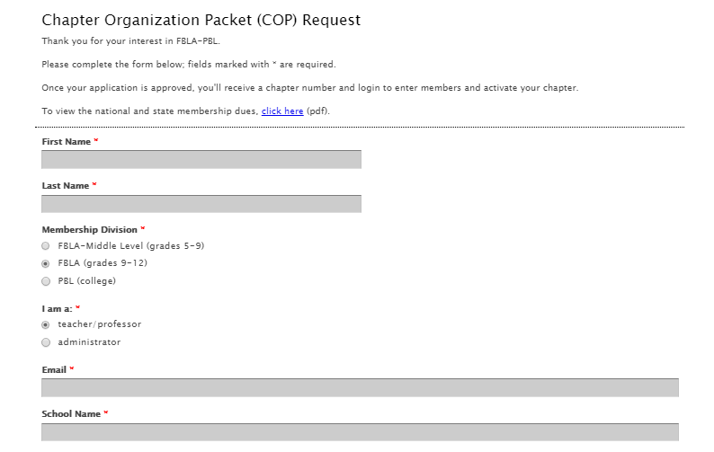
Register for your organizational Packet
You will go to the National Site and fill in the form to initiate the process of starting a new chapter.
Chapter Organization Packet
They will send you an email with your log in information. You will receive a chapter number and the password for the site.
You may also receive an email from your state Adviser. In NC, the state adviser is Mrs. Mary Jane Thomas.

Slide 7
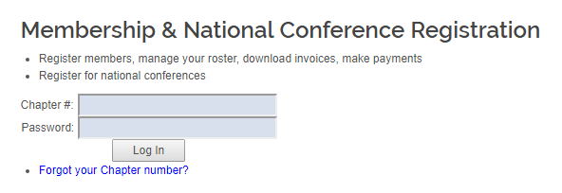
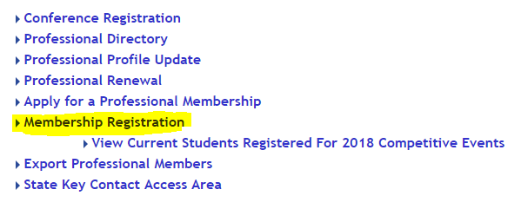
Register Your Chapter and Pay
Now you have access to the national site with your chapter number and password, you can enter the information.
Membership Registration

Slide 8
Officers
Have an Executive Board – Officers
What is an Executive Board? Why is an Executive Board Important?
The executive board is the governing body of a chapter. They ensure that the chapter is active by planning social, fundraising, and recruitment events, preparing for competitive events, and meeting the needs of the individual chapter.
Executive Board Offices
Most chapters have five to seven officers on their executive board, but you may just have a president and a secretary or what works for YOU.
Some offices you can choose:
President
Vice President
Secretary
Treasurer
Reporter
Historian
Parliamentarian
Officer Duties

Slide 9
ByLaws
Create Bylaws
Bylaws are the rules by which a chapter regulates its affairs and the behavior of its members.
FBLA-PBL strongly recommends that each local chapter creates bylaws for its chapter to abide by.
These could be: how you vote for officers, who can attend competitions, goals for the year, etc.
Sample FBLA-PBL Chapter Bylaws
You can modify this FBLA Chapter Bylaws template and review the National FBLA Bylaws.

Slide 10
Program of work
Create a Program of Work
What is a Program of Work? And Why is it Important?
The Program of Work is the action plan of a chapter. Strong Programs of Work include well-defined goals and objectives, deadlines, and assigned tasks. The Program of Work is important because it ensures careful planning and a detailed layout for the fiscal year.
This could be as simple as:
Review the Program of Work for the FBLA National Officers for ideas on programs and activities your new chapter can focus on.
Dates | Activity | Responsible
September 1-30 | Membership Drive | Officers, Adviser
October 1-31 | Krispy Kreme Fundraiser | All Members

Slide 11
Meetings
Step 7
Set Officer and General Meetings Dates/Agendas
Many successful chapters layout dates and locations of each other their meetings in the beginning of the year. This ensures the chapter has a meeting place and the dates and locations can be published and publicized to members and prospective members. In addition, they create agendas that layout exactly what is to be discussed at each meeting. This can be done well in advance or weekly by your officers.

Slide 12
Additional Info: Conferences and Competitions

Slide 13
Competitions and Conferences
Each conference has workshops and also competitions. If you would like to attend but are not ready to prepare for competitive events, attending a conference will give you and your students insight into competing.
There are different types of conferences/competitions.
Regional Competitive Events (RCE)- Typically happens in the fall/winter. Can be a conference also. Watch for information from your Regional Board Member or Regional Adviser or Regional Vice President for more information about the dates,, cost, and plans.
National Fall Leadership Conference (NFLC)- In November 2018, Charlotte, NC will be hosting a National Conference. This is an excellent way to allow your students to see the national level with workshops, speakers and no pressure of competing.
State Leadership Conference (SLC)- March 2019 at the Koury Convention Center in Greensboro, NC. There are workshops, competitions, speakers, and a great chance to network with other members and advisers across the state.
National Leadership Conference (NLC)- Vary year to year in location. Competions and workshops similar to SLC, but on a national level.

Slide 14
Competitions Regional Competitions
NC FBLA has a few competitions that start at the regional competitions. To register for State competition in these events, means that your student must have placed 1-3 at the regional level.
Business and Financial Literacy and Elevator Speech are Qualifiers for state and also national compeitions.
Business and Financial Literacy
Career Exploration
FBLA Creed
Introduction to Business Communication
Public Speaking
Elevator Speech
Spirit Cheer/Chant
Spirit T-Shirt
Spirit Cheer/Chant and Spirit T-Shirt are Team events. These two events compete against HS also. Only 1st place competes at SLC.

Slide 15
Competitions- State Leadership Conference
SLC gives the students an opportunity to network, learn and compete.
There are different types of competitions here:
Open Events- All Members may take these events, even if they have participated in another event. . Members can take as many as they would like. Both the active and associate members can take these.
Individual Events- These events are for a single competitor. The amount of competitors you can have in each event depend on how many members you have.
Group or Team Events- Group Events can have up to a certain number of members for each team.
Chapter Events- The Chapter works together to complete the competition. You would register the team leaders for this.
In the case of Individual and Group events, your members can ONLY compete in ONE event. For example, they can not do both Public Speaking and Presentation Software at the same time.
A student CAN compete in an Open Event, and Individual Event and a Chapter Event.

Slide 16
Steps In Review
Recruit at least 5 members
Register for your Organizational Packet
Pay your chapter dues and your Chapter Registration
Decide on Officers
Create Bylaws
Create a Program of Work for the year
Plan meeting dates and hold meetings
When ready:
Decide on competitions, regional events, state events, or national competitions.
Will you attend conferences?
How will you pay for the trips? Fundraisers?
And Finally:
Remember, starting a chapter does not mean you must do everything the first year! Have your students guide your program of work and decide what activities, trips, speakers, community service, fundraisers, competitions, or recognition programs you would like to do!

Slide 17
For Additional Information, help and Support
Sources:
FBLA National Site
FBLA ML Chapter Management Handbook
NCFBLA Document Site
NCFBLA Middle Level Info Page
Contact:
Julie West mailto:juliewest@currituck.k12.nc.us
NC FBLA ML Executive Board Member
NC FBLA Middle Level Advisers Area – Facebook Discussion Page

